Slide 1
APSSDC AWS CLOUD INTERNSHIP
Resolving Complaint Management with AWS Cloud Services
Presented by: Batch mates — a scalable, secure, serverless approach to streamline complaint intake, tracking, resolution, and analytics using AWS.
Batch mates:
Cheyyeti Hemanth kumar
Kakarapalli Teja Venkatesh
Ambati Dolanadh
Kalluri Leela Naga Babu

Slide 2
Problem Statement
Organizations receive high volumes of complaints across channels (email, web, phone, social). Current workflows are manual, siloed, and slow — causing delayed resolutions, inconsistent records, poor visibility, and low customer satisfaction.
Challenges
Goals
- Fragmented data sources
- Long resolution time
- Lack of audit trails
- Centralize intake
- Automate routing & notifications
- Provide analytics and auditability

Slide 3

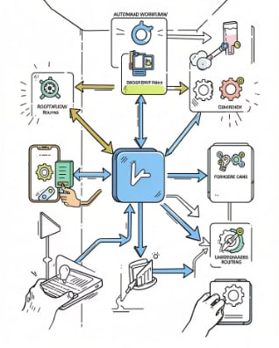
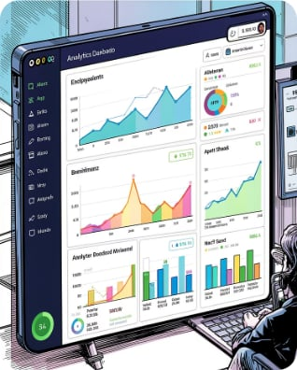
Our Solution: An AWS-Powered Complaint Management System
We built a serverless platform on AWS that centralizes complaint intake, enables automated triage and routing, provides a real-time admin dashboard, and stores immutable logs for compliance.
Unified Intake
Automated Triage
Insights & Reporting
Multi-channel capture (web forms, email, phone transcripts, social) funnels into a single API endpoint for consistent processing.
Lambda functions apply business rules and sentiment analysis to prioritize and assign cases automatically.
Aggregate metrics and trends drive continuous improvement and faster resolution times.

Slide 4
Key Features
Real-time Case Tracking
AI-assisted Triage
Live status updates, SLA timers, and activity history.
Sentiment and keyword extraction to prioritize urgent cases.
Automated Notifications
Immutable Audit Trail
Email/SMS/push alerts for customers and agents at each milestone.
Secure event logging for compliance and dispute resolution.
Role-based Dashboard
Scalable & Cost-effective
Custom views for agents, supervisors, and auditors.
Serverless design scales automatically and minimizes operational overhead.

Slide 5



AWS Services Utilized
Core services selected to build a resilient, serverless complaint management system:
S3
Lambda
Stores attachments, call recordings, and export archives with lifecycle policies.
Serverless processors for validation, enrichment, triage, and integrations.
DynamoDB
API Gateway
Fast, cost-effective storage of case records, indexes for queries and TTL for retention.
Secure REST endpoints for intake, agent actions, and integrations with throttling and auth.
Cognito
CloudWatch
Authentication and role-based access control for users and administrators.
Monitoring, logs, alarms, and dashboards for operational visibility.

Slide 6

Architecture
User Channels
API Gateway
Lambda Validation
DynamoDB & Support
Serverless flow ensures low-latency intake, near-instant routing, and durable storage. Components are loosely coupled to enable independent scaling and easy maintenance.

Slide 7


Administrator Dashboard: Real-time Tracking and Resolution
1
2
Live Queue
Agent Activity
Filterable case list with priority, owner, SLA progress, and quick actions.
Realtime presence, throughput, and response time metrics to balance workloads.
3
Case Timeline
Full interaction history including attachments, status changes, and notes.

Slide 8
Security and Scalability: Built-in AWS Advantages
Security
Scalability
Data encryption at rest (S3/DynamoDB) and in transit (TLS), fine-grained IAM roles, and Cognito-based authentication.
Lambda concurrency, DynamoDB on-demand or autoscaling, and S3 virtually unlimited storage handle spikes gracefully.
Compliance
Resiliency
Audit logging with CloudWatch Logs and S3 access logs for traceability and retention policies for records.
Retry logic, dead-letter queues, and cross-region backups protect availability and durability.

Slide 9
Impact & Benefits
50%
30%
40%
Faster Resolutions
Reduced Operational Cost
Higher Satisfaction
Automated triage reduces average time-to-first-response dramatically.
Serverless model lowers infrastructure and maintenance expenses.
Tracking, notifications, and transparency improve CSAT and retention.
Combined, these outcomes translate to measurable improvements in service quality, compliance posture, and operational efficiency.

Slide 10

Conclusion & Next Steps
We propose a phased rollout: pilot with one business unit → refine rules & ML models → enterprise rollout with monitoring and governance. The AWS serverless stack delivers a secure, scalable, and cost-effective foundation for modern complaint management.
Next step: Schedule a 2-week pilot to validate intake, routing rules, and dashboard metrics.

